Slide 1
Don’t be a word bore

Slide 2
beautiful

Slide 3
beautiful
attractive
pretty
handsome
good-looking
nice-looking
pleasing
alluring
prepossessing
as pretty as a picture

Slide 4
lovely
charming
delightful
appealing
engaging
winsome
ravishing
gorgeous
heavenly
stunning

Slide 5
because
as a result
consequently
due to
thus
accordingly
hence
as

Slide 6
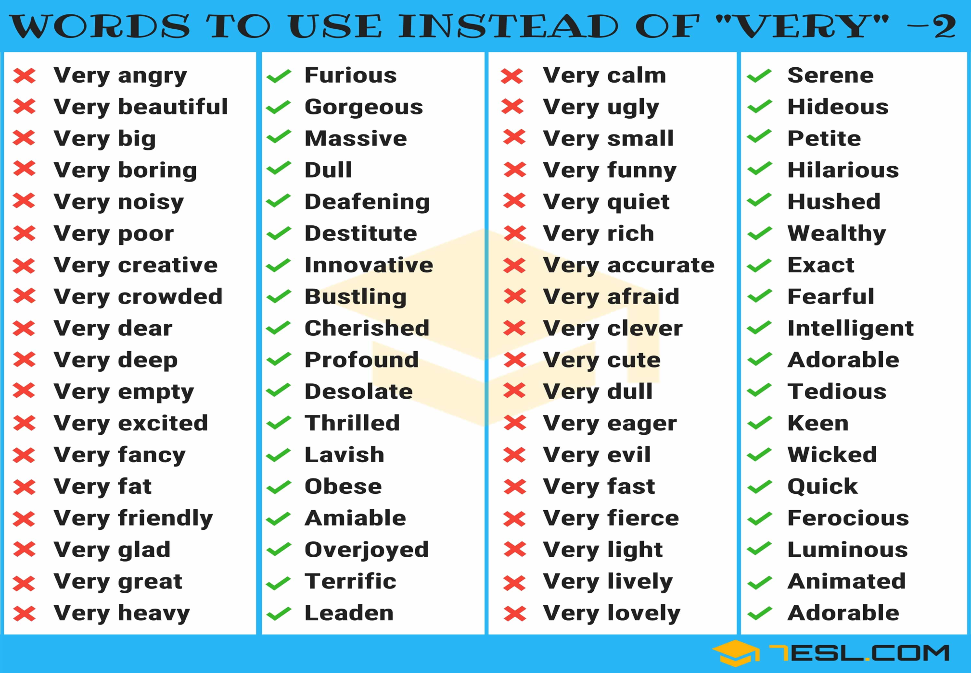

Slide 7
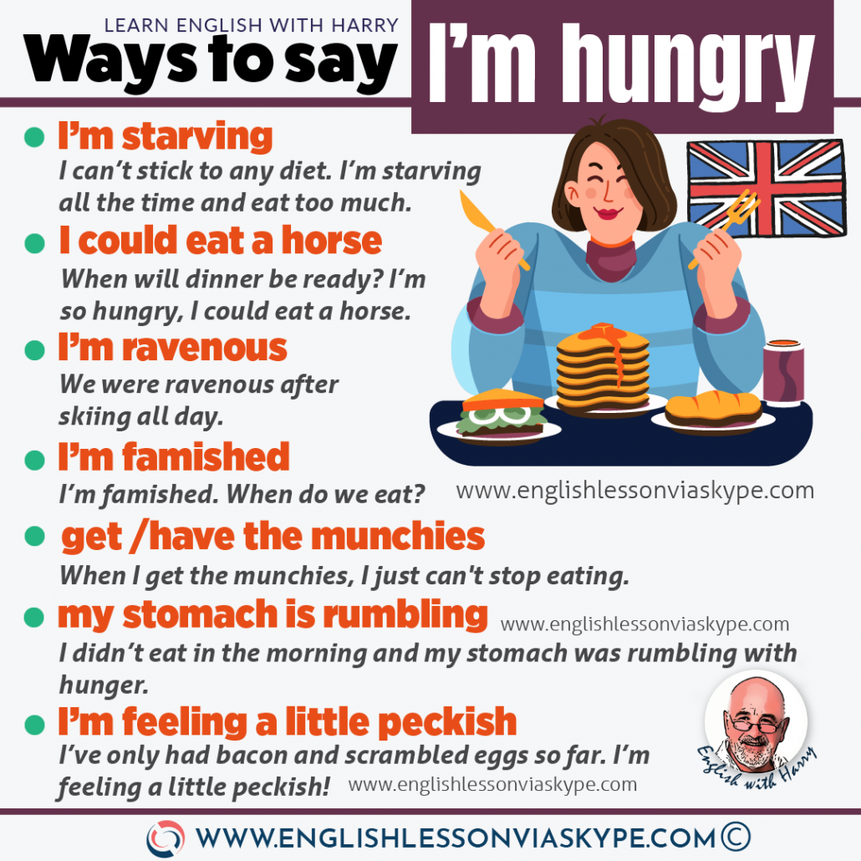

Slide 8
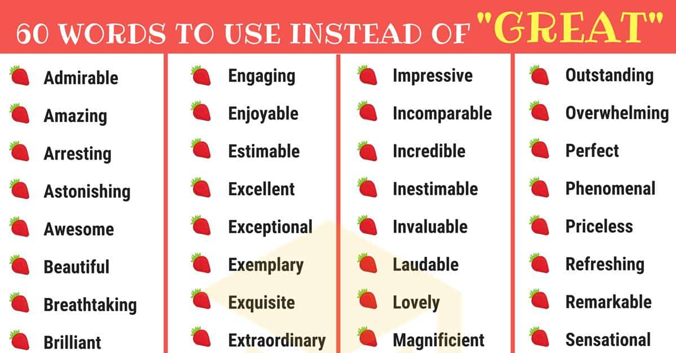

Slide 9
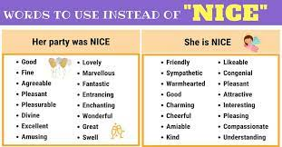

Slide 10
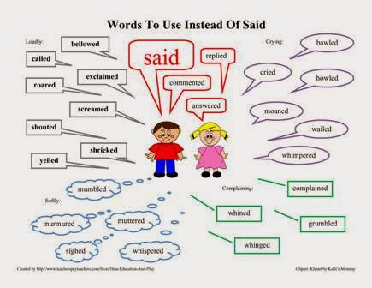

Slide 11
Please
Sorry
I ‘m fine
I’m tired
I’m bored
I’m sad

Slide 12
Please-I wonder
Sorry-Apologies
I ‘m fine- I’m well
I’m tired-drained
I’m bored-snored
I’m sad-gutted

Slide 13
Old person

Slide 14
Pensioner
Retiree
Senior
Old ster
Old-timer
Geriatric
Elderly person
Old fogey

Slide 15
mistake

Slide 16
Blunder
Error
Misjudgement
Miscalculation
Trip
Misstep,
Misunderstanding
Slip up
Lapse

Slide 17
rodomontade

Slide 18
Rodomontade" means a vainglorious brag or boast, or an extravagantly boastful, arrogant, or bombastic speech or piece of writing
bluster
boast
bombast
braggart
grandiloquence
pretension
pride
rant

Slide 19
Raju’s boastful rodomontade was parodied in the classroom.
She amused him with some rodomontade about despising rank and wealth

Slide 20
A fawning sycophant

Slide 21
A fawning sycophant is a person who is a self-seeking flatterer who attempts to win favor from others through fawning behavior

Slide 22
Vocabulary
1 The police caught and ……… the gang twenty miles from the scene of the robbery.
Prosecuted arrested accused
2 The politician has ……….refused to speak to the media after recent
of corruption against him.
Obligations allegations altercations
3 Many observers are sure that the elections were ……
Rigged ripped
4 The strike began with mass……. at factories across the country. Workers downed tools and refused to work.
Redundancies workouts walkouts
5 Police ……. with demonstrators as ten thousand people gathered to protest against government cuts.
Clashed crashed grasped

Slide 23
6 There are many ……to overcome before the new system can be implemented.
Hurdles barriers walls
7 The president …..the crisis by saying it wasn't as serious as the media had reported.
Downplayed reduced lessened
8 The suspect was …. and questioned for two days, before being released.
Detained retained maintained
9 Extra security will be brought in for the political …. , as the crowd is expected to exceed ten thousand.
Relay rally rail
10 After many years of bad relations, the country now wants to repair …..with its neighbours.
Contacts ties talks

Slide 24
In/on
The correct phrase to use depends on the spatial relationship between you and the vehicle:
In the car: Used when you are inside the vehicle, such as a passenger or driver.
On the car: Used when you are on top of the vehicle, such as for a photo or to enjoy a view
in when you are talking about a small vehicle or a personal vehicle. Use on when you are talking about a large vehicle or a public vehicle

Slide 25
…..the car
….the train
…bus
…plane
…Bicycle
…..motorbike

Slide 26
In can be a noun, a preposition, an adverb, an adjective, . In means within or inside.
In is used for location and condition.
Ex: My mother is in house, and she is in a good mood.
If you use in as an adverb it shows movement.
Ex: Sheena drinks coffee with milk in.
Ex: They went in when we visited

Slide 27
The foremost difference between into and in is that into shows movement, whereas in shows a position inside.

Slide 28
Into is used as a preposition; it shows movement and direction from outside to inside.
Ex:They are rushing into the house.
Ex: Come into my house.
Ex: He threw her wife into the fire.
Into is also used to show a change in state.
Ex: The frog turned into a prince.
Ex: We translate the English into Hindi.

Slide 29
In to is combined form of In as an adverb and to as a preposition or infinitive, like to see, to go, to run, to walk, etc.
Ex:She went in to see her husband. (Here to is working as infinitive.)
Ex:The assistant takes the day's agenda in to the president. (Here to is preposition.)

Slide 30
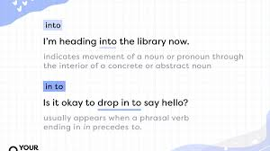

Slide 31
Source
https://digitalsynopsis.com/tools/words-to-use-instead-of-good/

